Slide 1

Car renter application
Made by Dávid Balogh ,Valentin Szilveszter Füredel, Levente Tarnóczi

Slide 2
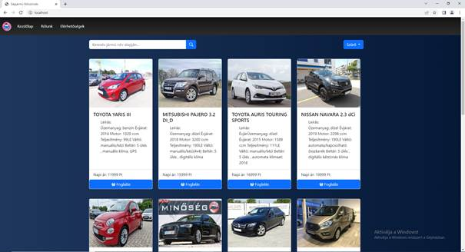

Information about the application
Notes:
((DÁVID))
In our project theme is car renting. We have a web application and java application.
The web application made for the uses who want to rent a car . You can handle your own profile.
The java applicaion made for the company workers because they manage the cars and the rents.

Slide 3




Programming languages
Notes:
((DÁVID))
We used this program language .`’{/[(„ITT SOROD FEL ŐKET” )]/}’`

Slide 4
System requirements
Minimal system requirements:
Operation System: Windows 10/Linux/MacOS
Processor: 1 GHz or more
RAM: 1 GB
Storage size: 1 GB
GPU: DirectX 9 version or newer
Screen size: 800x600
Optimal system requirements:
Operation System: Windows 10/Linux/MacOS
Processor: 2 GHz or more
RAM: 2 GB
Storage size: 1 GB
GPU: DirectX 9 version or newer
Screen size: 1280x1024
Notes:
((DÁVID))
This is the system requirements, this is a default OS system requirements

Slide 5
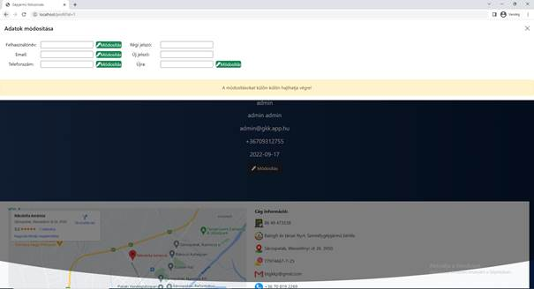
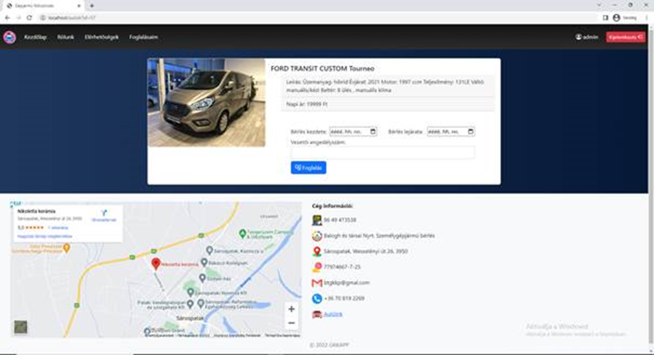
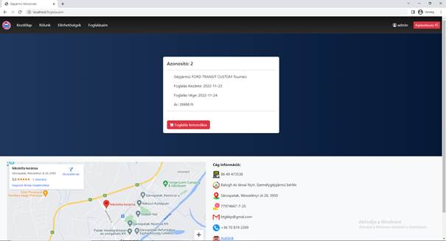
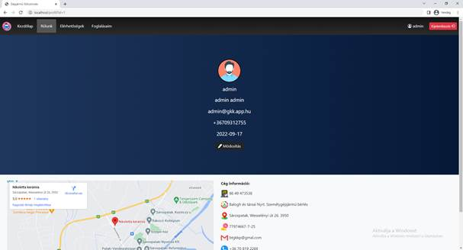
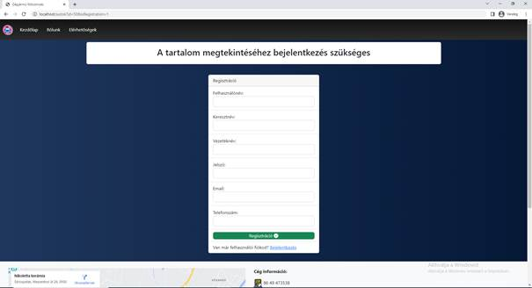
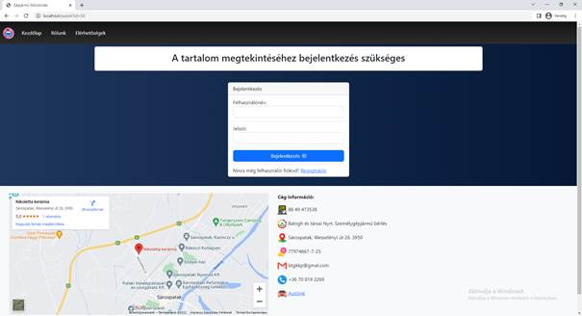
The web application
Notes:
((SZILVI))
In the web application you can login(NYOMD!) and register(NYOMD!) .After registration you can choose a car (NYOMD!)on this page. After that you (NYOMD!)can rent a car . (NYOMD!)In the „Foglalásaim” page it shows your rents and you can resign it. If you click there (mutass jobb felülre a kijelentkezés mellé) (NYOMD!) it will forward you to your profil page where you can (NYOMD!)modify your account.

Slide 6
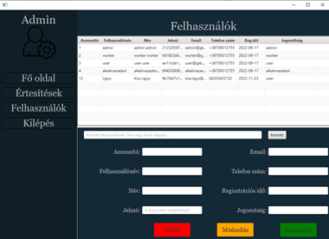
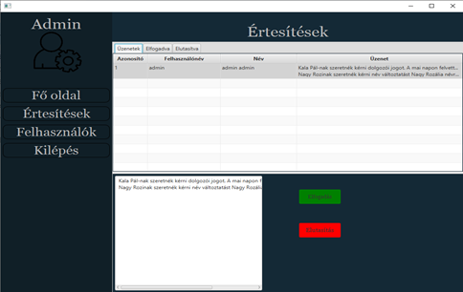
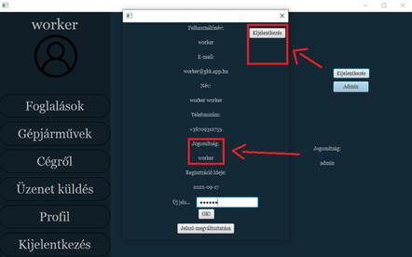
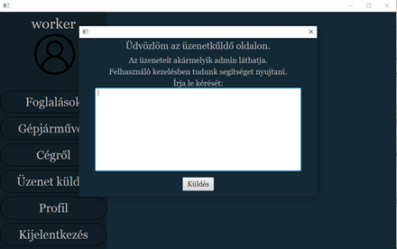
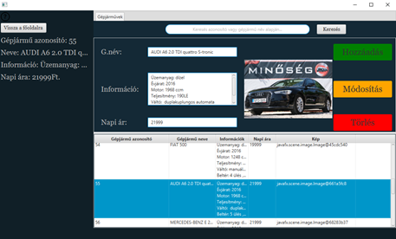
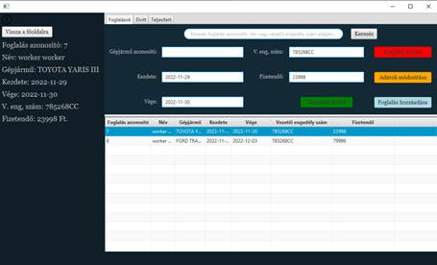
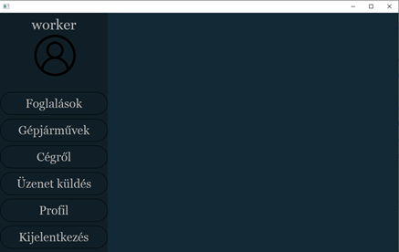
Java application
Notes:
((LEVI))
In the java application the worker can handle the rents(NYOMD!) like delete it and modifing it or add new rents. (NYOMD!)And you can add,modify and delete cars on „Gépjárművek” page . (NYOMD!)The worker can send message for the admin in the „Üzenet küldés” page if you have a problem. (NYOMD!)In the „Profil” page you can see your profile datas. If you an admin you have a admin button in „Profil” page and it shows the admin page where you (NYOMD!)can handle messages and(NYOMD!) users datas.

Slide 7
Thank you for your attention!

